Slide 1

Building Microcontroller
Games
Fuse Code Camp
Keith Gasper & Prishant Mantrao
May 4, 2019

Slide 2
Introduction Time!
Introduce yourself to the rest of the class. Tell us:
Your Name
Your school and school mascot
Your favorite video game, movie, or musician
What kinds of programming have you done
What you hope to learn about today

Slide 3
What are we going to learn today?
By the end of the class, you will:
Understand what a microcontroller is
Know how to write & load programs onto your micro:bit
Learn some basic programming concepts
Know where to find sample micro:bit programs and documentation
Learn some brainstorming, problem solving, and collaboration skills
Learn what it’s like to work as a software engineer

Slide 4
Lesson Schedule
We have 6 lessons today:
Intro to microcontrollers and your micro:bit
Basics of programming your micro:bit
Programming basics, LEDs, buttons
Communicating using the micro:bit radio
Programming a group game
Brainstorming, building, and playing your own games

Slide 5
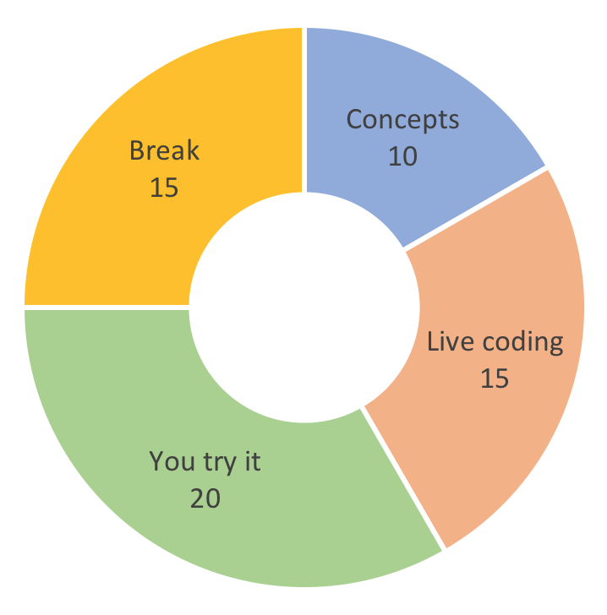
Lesson Breakdown
Here’s what to expect in each lesson
Learning new concepts
Guided live coding exercises
Spend some time on your own
15 minute break

Slide 6
Other Stuff…
Show & Tell at 4pm
Brainstorming: put your ideas on sticky notes
Pairing
Clap!
Food
Music playlist requests for lesson 6
Questions???

Slide 7
Lesson 1

Slide 8
Intro to microcontrollers and your micro:bit
In this lesson we will:
Learn what a computer and microcontroller is
Learn what programming is
Talk about how we will program the micro:bit
Cover some basic safety
Play with our micro:bit microcontrollers!

Slide 9
What is a computer?
Notes:
A computer is a machine that receives some data which it then processes and outputs. You have your own computer called a brain. When a teacher asks you to calculate 4 x 4 this is known as data. At some stage you will have been taught to process this data by adding 4 + 4 + 4 + 4 together. The answer you give is the output of your calculation.
In order to process data, a computer must receive instructions or commands. However, it would be unfeasible to make the user input commands for everything. Even something as simple as saving a document or opening a browser takes thousands or even millions of lines of code. In response to this problem, stored programs have been invented.

Slide 10
What is a computer?
Notes:
The Processor – this is usually a small chip inside the computer, and it’s how the computer processes and transforms information. Has anyone heard of the term “CPU”? CPU stands for Central Processing Unit. You can think of the processor as the Brains of the computer - the faster the processor, the more quickly the computer can think.
The Memory – this is how the computer remembers things. There are two types of memory:
RAM (random access memory) - you can think of this as the computer’s short-term memory
Storage (also referred to as the “hard drive”) - this is the computer’s long-term memory, where it can store information even when power is turned off
Inputs – this is how a computer takes in information from the world. On humans, our input comes in through our senses, such as our ears and eyes. What are some Computer Inputs? Keyboard, Mouse, Touchscreen, Camera, Microphone, Game Controller, Scanner
Outputs – this is how a computer displays or communicates information. On humans, we communicate information by using our mouths when we talk. What are some examples of communication that don’t involve talking? Blushing, sign language. What are some examples of Computer outputs? Monitor/Screen, Headphones/Speakers, Printer

Slide 11
What is a microcontroller?

Slide 12
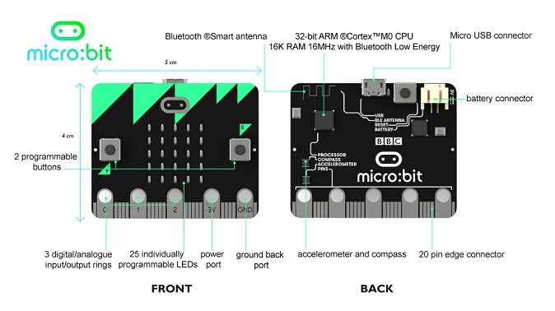
What is a microcontroller?
Notes:
A small self-contained computer
Use the features page on the microbit website as a visual aid
Can you find the Processor?
How much memory does the micro:bit have? 16K, which is smaller than many files on your computer!
Can you locate the following Inputs? Buttons (on board), Pins (at base), Accelerometer / Compass.Note: Though not pictured, the Light Sensor is located on the LED lights
Where are the Outputs? LED lights, Pins
All computers need electricity to power them. There are 3 ways to power your micro:bit:
Through the USB port at the top
By connecting a battery pack to the battery connector
Through the 3V Pin at the bottom (not the recommended way to power your micro:bit)
On the top left corner you may notice that your micro:bit has a Bluetooth antenna. This means your micro:bit can communicate and send information to other micro:bits. We will learn more about this feature in the Radio Lesson.

Slide 13
Can you find the… ?

Slide 14
What is programming?
Notes:
Solving a problem by

Slide 15
What is a programming language?

Slide 16
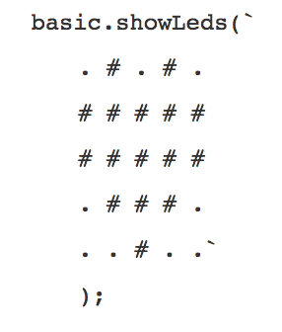
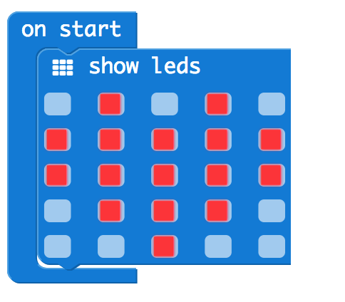
How will we be programming?
High-level programming language
Blockly
JavaScript
Compiler
makecode.microbit.org
Machine Code
hex
“microbit-xxxx.hex”

Slide 17
Safety First!
Follow these precautions to avoid damaging your micro:bit
Keep your micro:bit in an anti-static bag when not using it
Handle the micro:bit by its edges
Only use the battery pack and USB cord that was provided (do not use portable battery chargers or USB charging ports)
Do not keep your micro:bit if it appears to be damaged! Replace it as soon as possible to avoid damaging your computer

Slide 18
Lesson 2

Slide 19
Basics of Programming your micro:bit
In this lesson we will:
Connect micro:bit to your computer
Cover the basics of the Blockly IDE
Load example programs onto your micro:bit
Learn how to find example programs to play with

Slide 20
Quick start guide
Let’s learn how to program our micro:bit
Quick start guide: http://microbit.org/guide/quick/
Micro:bit documentation: https://makecode.microbit.org/docs
Sample projects: https://makecode.microbit.org/projects

Slide 21
Loading sample projects
There are lots of great sample projects
Coin Flipper: https://makecode.microbit.org/projects/coin-flipper
Rock Paper Scissors: https://makecode.microbit.org/projects/rock-paper-scissors
Compass: https://makecode.microbit.org/projects/compass

Slide 22
Lesson 3

Slide 23
Programming basics, LEDs, buttons
In this lesson we will:
Learn some of the basics of Blockly
Program the LED grid
Program some button behavior
Talk about programming micro:bit with JavaScript

Slide 24
Blockly basics
Building programs by arranging blocks into a picture
Has anyone used Scratch?
Look for tabs and puzzle pieces on blocks to fit them together
Blocks are color coded by type
Blockly reference guide: https://makecode.microbit.org/reference

Slide 25
Programming the LED grid
Building programs by arranging blocks into a picture
LED: light emitting diode
micro:bit has 25 LEDs arranged in a grid
Can display text and numbers, draw pictures, create animations
Basic block documentation: https://makecode.microbit.org/reference/basic

Slide 26
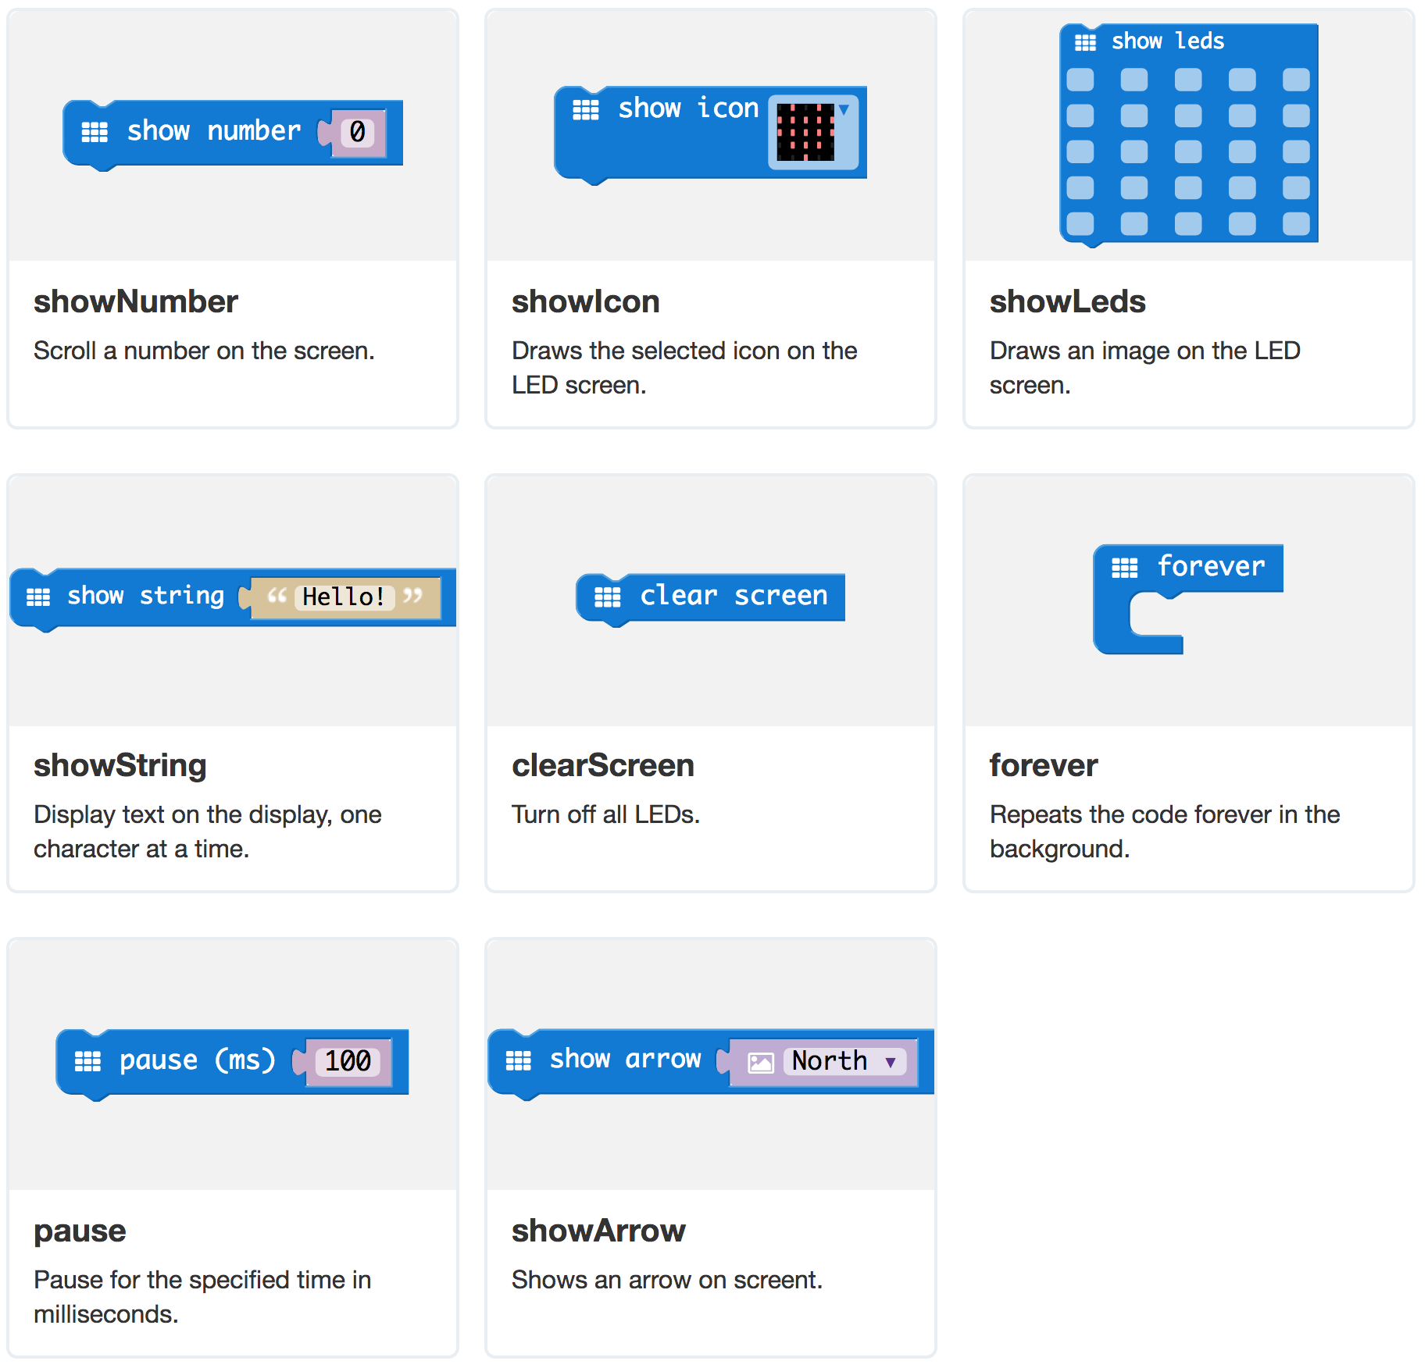
Basic blocks

Slide 27
Programming buttons
Let’s tell the micro:bit how to do something when a button is pressed
micro:bit has 2 programmable buttons
Buttons are examples of user input
Inputs create events which can be reacted to
Input block documentation: https://makecode.microbit.org/reference/input

Slide 28
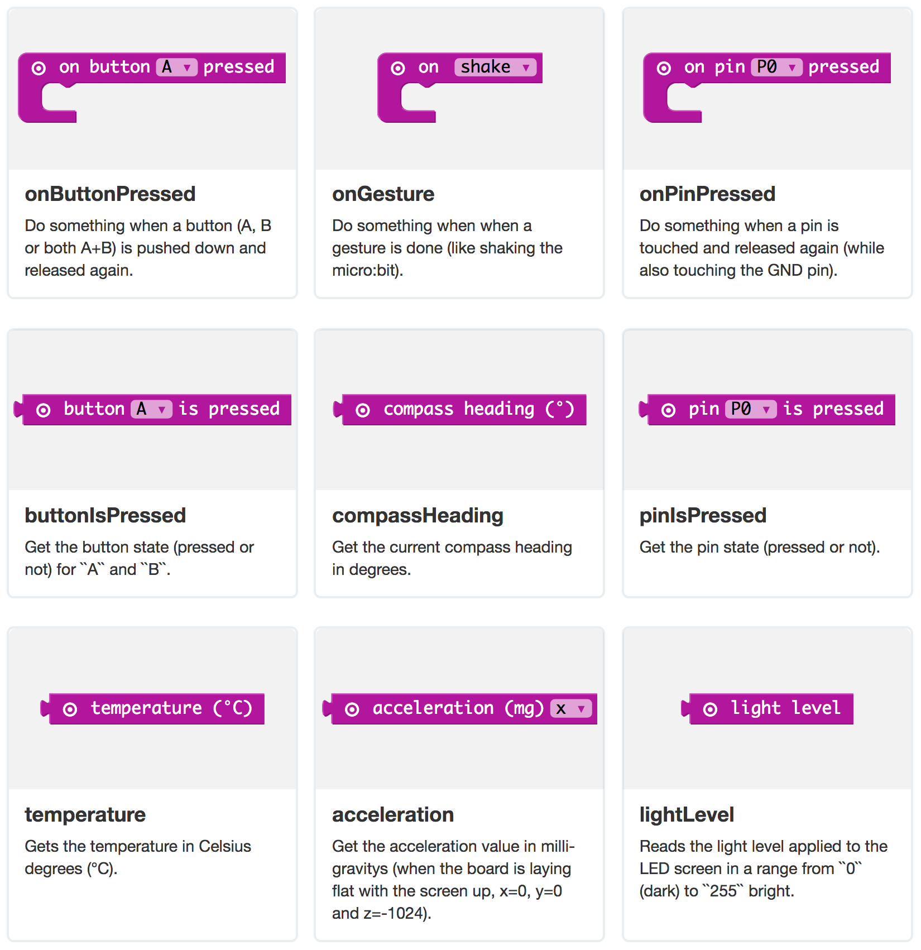
Input blocks

Slide 29
Lesson 4

Slide 30
Communicating using the micro:bit radio
In this lesson we will:
Learn how to communicate wirelessly using radio
Write some simple radio communication programs
Create a hide and seek game in pairs and play

Slide 31
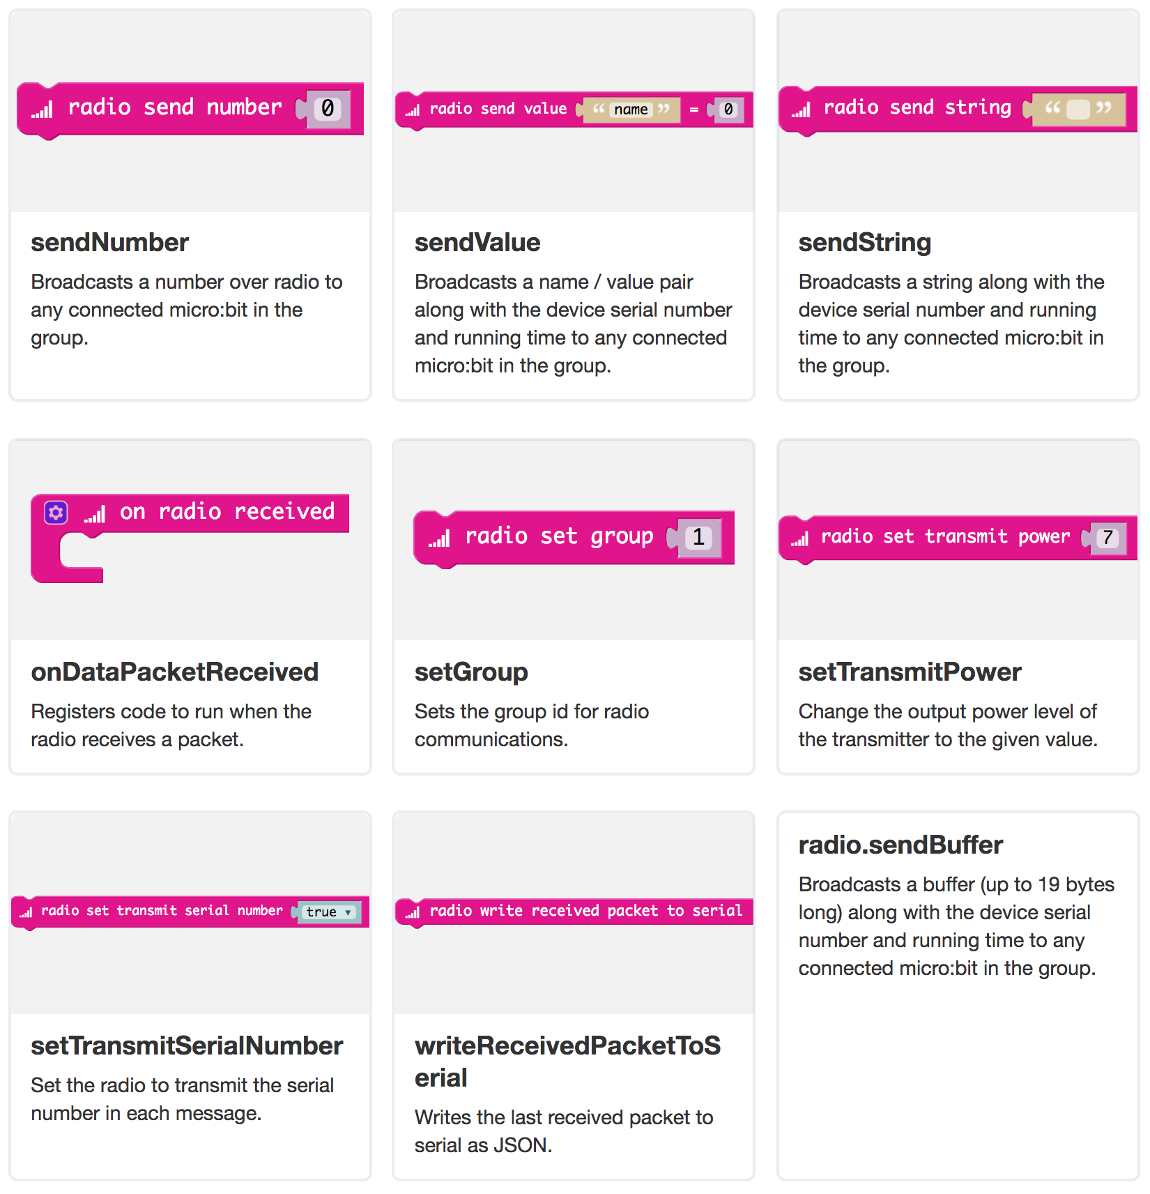
Radio Blocks

Slide 32
Lesson 5

Slide 33
Programming a group game
In this lesson we will:
Learn about game blocks
Program a group game the entire class can play
Review the game code, suggest changes, make improvements

Slide 34
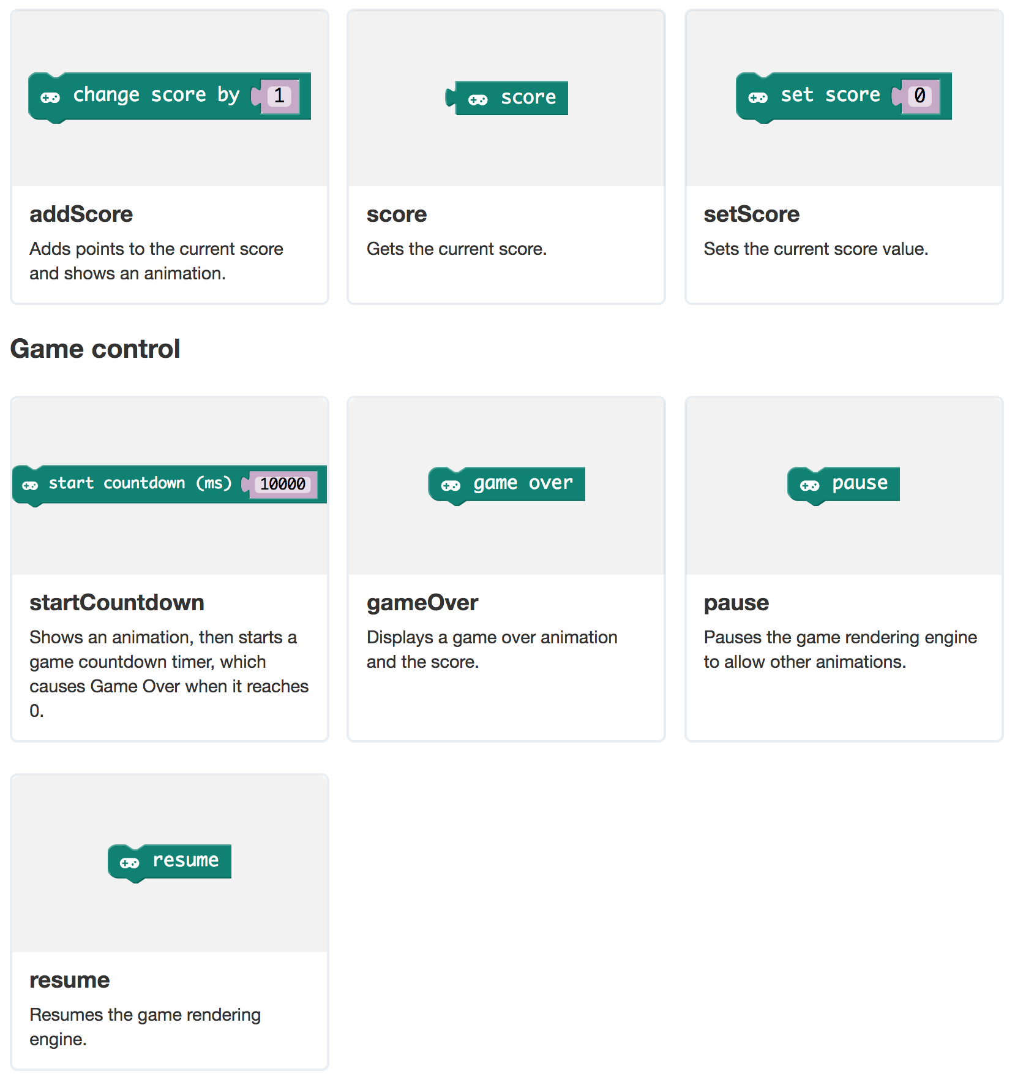
Game Blocks

Slide 35
Lesson 6

Slide 36
Brainstorming, building, and playing your own games
In this lesson we will:
Have a group brainstorming session to collect ideas
Choose projects to work on individually or in groups
Work on our class Show & Tell presentation

Slide 37
Time to Brainstorm!
Let’s think of project ideas that we can build
Write your ideas on sticky notes & post them on the whiteboard
We’ll review all the ideas as a group
Pick something you’d like to work on – teams are encouraged!

